Slide 1
WISHIN Overview 2018 Safety-Net Summit November 2, 2018

Slide 2
Outline
Introduction
About WISHIN
WISHIN Products and Services
WISHIN Pulse
Direct Messaging
Notifications
Near-Future Plans
Participation Statistics
Questions/Summit Invitation

Slide 3
About WISHIN
An independent not-for-profit organization
Appointed as the State-Designated Entity for Wisconsin’s health information exchange (Act 274)
Founded by the following organizations:
Wisconsin Hospital Association
Wisconsin Medical Society
Wisconsin Health Information Organization
Wisconsin Collaborative for Healthcare Quality

Slide 4
About WISHIN
Dedicated to bringing the benefits of widespread, secure, & interoperable health information technology to caregivers throughout Wisconsin
Building a statewide health information network that connects hospitals, clinics, managed care organizations, skilled nursing facilities, home health agencies, and anyone else involved in patient care.
The network provides a community health record for a patient, accessible by all WISHIN participants involved in that patient’s care.

Slide 5
WISHIN Products and Services
WISHIN Pulse – a longitudinal, patient-centric community health record
Public Health Reporting Services – interfaces through WISHIN to state reporting agencies
Direct Messaging – point-to-point messaging designed specifically for exchanging patient health information
Notifications – through a partnership with PatientPing, configurable real-time or batch notifications

Slide 6
WISHIN Pulse

Slide 7
WISHIN Pulse
Pulse is a community health record:
A patient-centered longitudinal view of health information.
No need to know where the patient has had previous health care encounters.
Clinical data is not segregated by provider source.
Pulse can include the following data:
ADT (demographics, allergies, diagnoses, insurance information, etc.)
Laboratory and pathology results
Radiology, EKG, and transcription reports
CCDAs (i.e., care summaries or transition of care documents)
Immunizations
Medicaid prescription-fill data
Connection to the enhanced Prescription Drug Monitoring Program (ePDMP)

Slide 8
WISHIN Pulse
All Pulse participants are automatically connected to WISHIN’s national connections:
eHealth Exchange (Sequoia Project), which is the nationwide health exchange network:
UnityPoint
VA
DaVita
Future plans are to connect to other HIEs across the country

Slide 9
How it Works: Contributing Data
Interface Feed
Organizations contribute data from their EHRs through real-time interface feeds, or via flat files
Pulse Processing
WISHIN Pulse processes the data and stores it on each organization’s edge server
Master Patient Index
WISHIN Pulse writes limited patient demographics to the Master Patient Index and does patient matching
Record Locator
WISHIN Pulse writes keys to the record locator service, to indicate where patient records are stored
Step 4
Step 3
Step 2
Step 1
Page 9

Slide 10
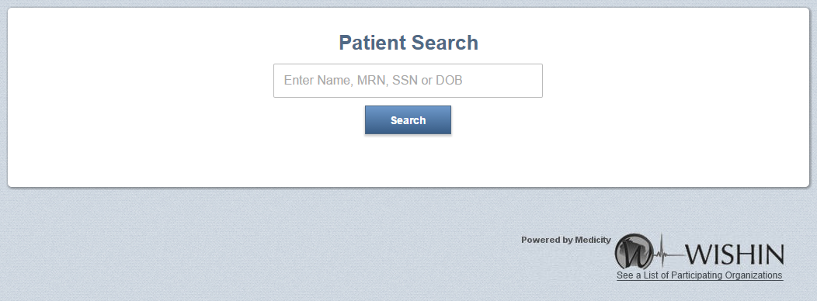
How it Works: Querying Data
Authorized user queries for a patient, based upon his/her own organization’s MRN, or other demographics, such as name or date of birth
WISHIN Pulse returns all matches for the search
When the user selects a patient, WISHIN Pulse opens up a Patient Summary page (shown in the next slide).
Page 10

Slide 11
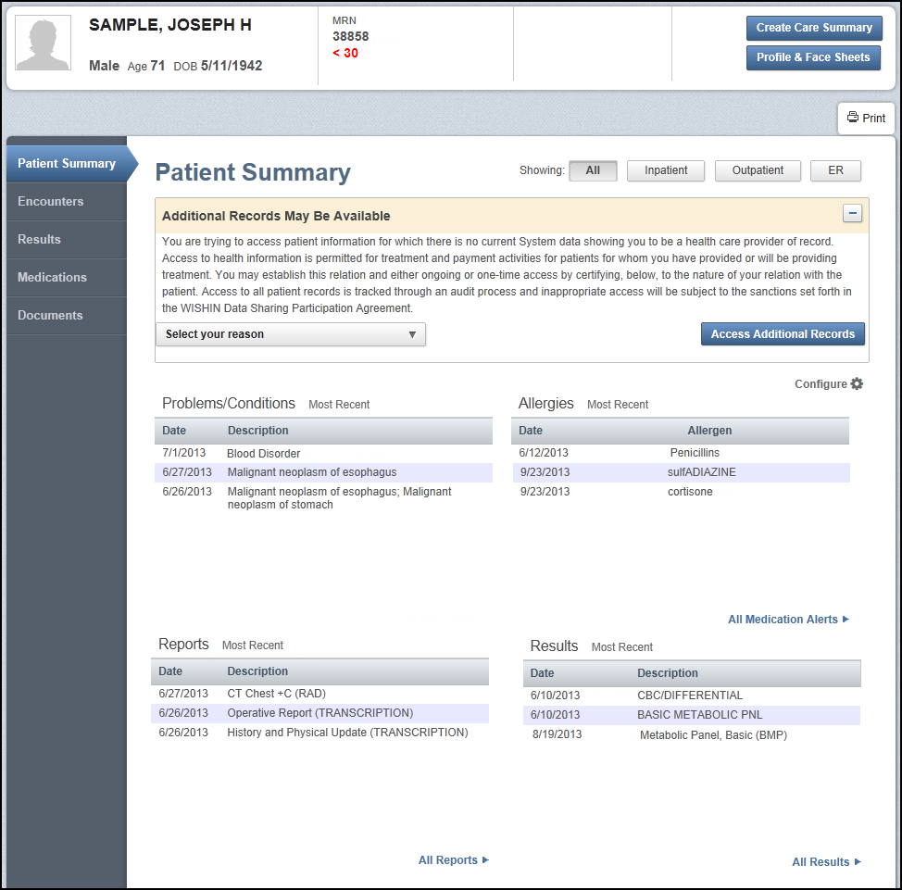
How it Works: Querying Data
WISHIN Pulse compiles the patient’s information into a summary view.
If WISHIN Pulse is integrated into the participant’s EHR, users will not be required to log in separately or perform a separate patient search.
Detailed information is available on other pages throughout the system.
Page 11

Slide 12
WISHIN Pulse Demonstration

Slide 13
Other Products and Services

Slide 14
Direct Messaging
Two types of services available:
HISP service that integrates with an EHR system
Webmail
Allows customers to participate in electronic transitions of care, where they may not have been able to do so due to technical constraints
Free when an organization signs up for WISHIN Pulse, or can be priced separately
Public Health Reporting
Can implement:
Public Health Syndromic Surveillance
Immunizations (if EHR system has interface)
Working with the state on a project to streamline the implementation process for all public health measures

Slide 15
Real-time Notifications
WISHIN has partnered with PatientPing, which provides real-time notifications:
Integrate with WISHIN Pulse
Can integrate directly into an organization’s EHR or care-management system, or be sent via secure message, email, or text [without PHI on unsecure methods]
Analytics
WISHIN is developing a data warehouse and analytics tool.
The tool will contain several standard reports
Customers can receive data sets (either identifiable or non-identifiable, depending on the use case)
Customers may be able to develop their own reports/dashboards on data sets
WISHIN can develop custom reports for customers
Page 15

Slide 16
Current Statistics

Slide 17
Some of the participating organizations include:
Ascension Wisconsin (Columbia-St. Mary’s, Wheaton Franciscan, Ministry, Affinity)
Milwaukee community health systems (Aurora, Children’s, Froedtert)
Bellin and ThedaCare
ProHealth (Onboarding)
Dean/SSM hospitals and clinics
Watertown Regional Medical Center and clinics
United Hospital System
GI Associates
Safety-net clinics: ARCW, Sixteenth Street, Progressive, Outreach, Milwaukee Health Services, Kenosha, Ignace, Muslim CHC, Bread of Healing, Scenic Bluffs, Northlakes, ARCW
Many smaller hospitals including: Door County Medical Center hospital and clinics, Reedsburg Area Medical Center, Divine Savior Healthcare, Crossing Rivers Health
Independent Physician Associations: Wisconsin IPA, IPW

Slide 18
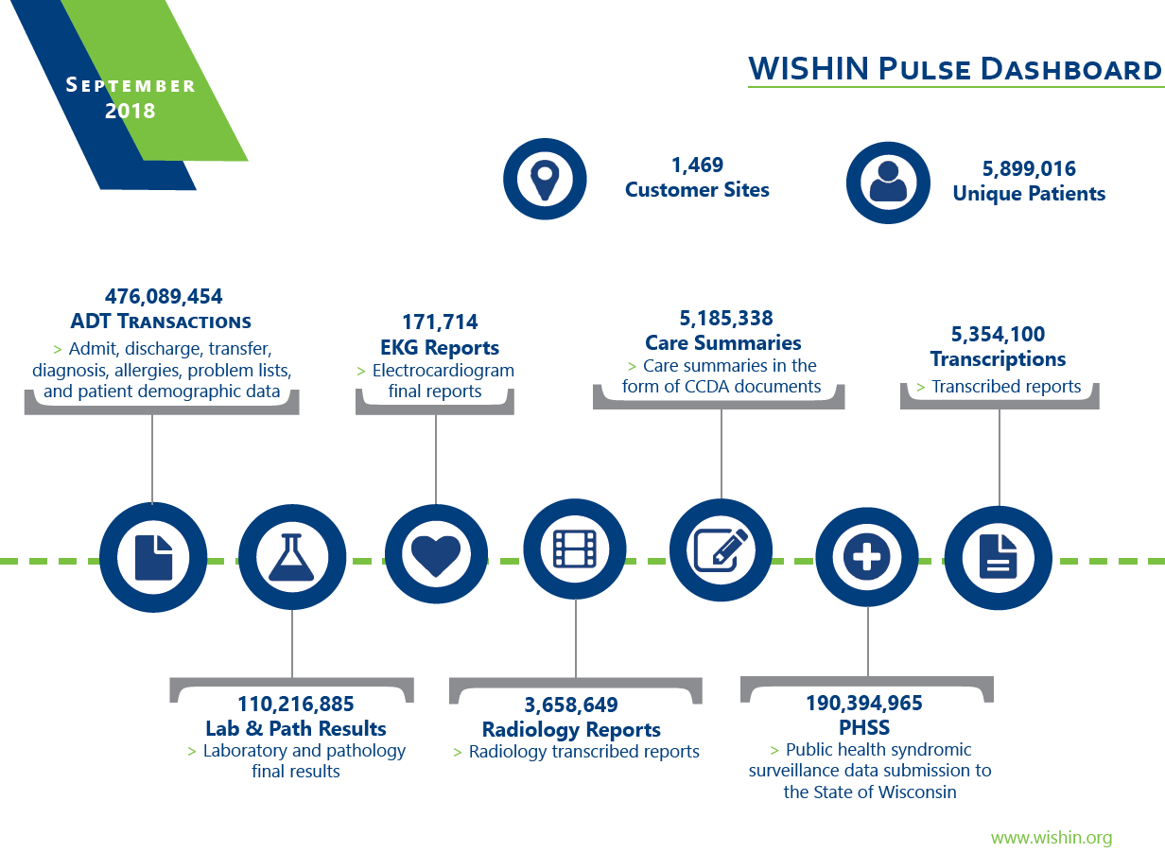

Slide 19
What does it take to Join?

Slide 20
Steps to Implement WISHIN
Sign a participation agreement – contains the data sharing and access provisions, business associate agreement, and other provisions
WISHIN has flexible implementation options for customers who do or do not have EHR systems:
Standard HL7 interfaces for EHR systems
EHR-level integrations with: Athena, eClinicalWorks, OCHIN
Flat file options for clinics without EHRs, or without EHRs that have interfaces available
Users can go live in the system before data is live
Training is provided at no additional cost
If also interested in PatientPing, it has its own contracting and fee schedule; it can be implemented at the same time or at a future date

Slide 21
For More Information

Slide 22
WISHIN’s 2018 Summit
Wednesday, November 14, 2018 from 8:00 am – 4:00 pm
Glacier Canyon Lodge at the Wilderness Resort, Wisconsin Dells
Focusing on how payers and providers across the state are using WISHIN to access clinical data from outside their own walls
Learn more about the WISHIN/PatientPing partnership to help with care coordination and more of the latest developments at WISHIN
To Register: http://events.r20.constantcontact.com/register/event?llr=5rquiugab&oeidk=a07efk6q2zcbc311a4c
Page 22

Slide 23
For Questions or More Information
Laura Widder, Project Director
Wisconsin Statewide Health Information Network
608-274-1820 | lwidder@wishin.org

