Slide 1
Interdisciplinary Approach to Diabetic Care in Free Clinics
Stacy Wolf, BSN, RN, CDE
RN Care Coordinator
Lauren Caruso, PharmD
Clinical Pharmacy Resident
Community Outreach Health Clinic (COHC)
Community Memorial Hospital
Menomonee Falls

Slide 2
COHC Interdisciplinary Team
Nurse Practitioner/ MD/Resident Physician
RN Care Coordinator/CDE
Clinical Pharmacy Resident
Dietician
Counselor
Psychiatrist
Others: volunteer RNs, students, schedulers, screeners, pharmacy techs

Slide 3
Advantages to Team-Based Care
Different perspectives on how to treat our challenging population
Holistic care - diagnostic/medicinal, lifestyle change, dietary advice, mental health counseling, psychiatric medicine
Unique strengths (e.g., culture, communication style) allow providers to form different bonds with patients
Collaboration to provide comprehensive, patient-centered care and build a trusting and lasting relationship with our patients
Notes:
Our providers have diverse experiences managing chronic disease states and dealing with more complex patient, both medically and socially.
We have wide variety of providers, including dietician, counselor, and psychiatrist, which enables us to provide holistic care and focus on positive lifestyle changes as well as improving mental health.
Each of our providers has unique strengths when interacting with our patients – ex: Sim has a unique connection with our Eastern Indian population, which has grown. Linda is very down to earth, empathetic, and compassionate; she understands how to serve and care for the socially complex patient (she is the backbone of our clinic!). Angie’s kindness and willingness to teach other providers and learners in our clinic make her an asset in providing high-quality patient care.
Image: https://www.bing.com/images/search?view=detailV2&ccid=W04FvuSs&id=46C8C03926AFB7ADD7B03AD00D7693871E932BAA&thid=OIP.W04FvuSsaFKE34sruEEanwHaEZ&mediaurl=https%3a%2f%2fnews.rutgers.edu%2fsites%2fmedrel%2ffiles%2finline-img%2fIPE%2520art%2520C.jpg&exph=370&expw=624&q=team+based+care+hands&simid=608025573406477642&selectedIndex=3&ajaxhist=0

Slide 4
Barriers in our Outreach Clinic
Ensuring continuity of care with multiple providers
Patients do not always see the same provider in clinic
Solutions:
Pre-clinic huddle and post-clinic debrief
RN Care Coordinator
Certain staff members are not present every evening
Dietician and psychiatrist only in clinic once per month
Pharmacy residents only twice per month
Solutions:
Proactive outreach – schedule appointments in advance
Notes:
We have implemented a pre-clinic huddle and post-clinic debrief with providers. In my role, I review charts and ensure our patients are meeting their standards of care and best practice measures (which I will elaborate on later).
When a provider that is not usually in clinic sees a patient we talk about the plan of care and follow up with the team to help ensure continuity (Ex: major insulin change – need to communicate when follow up is needed to monitor for hypoglycemia or further titrate if needed.
We preload/book patients for an appointment the dietician, psychiatrist and account for potential no shows to maximize their time in clinic. If all patients show up, I will plan accordingly so all patients are seen, triaging those that need to be seen by dietician and prioritizing those that need to be seen the most.
Call to remind patients of appointments the day of appointment prior to clinic starting to minimize no shows.

Slide 5
What barriers have you experienced in your clinics and how have you worked together to overcome them?

Slide 6
RN Care Coordinator Role
Complete pre-clinic chart review for primary care wellness as age and gender appropriate
Last CPE
Last PAP
Last Mammogram (Well Women’s Program)
Last dental, foot, and eye exam
Colonoscopy (Grant for free screening colonoscopy)
Routine lab work: A1C, CBC, BMP, FLP
Blood pressure reading
Tobacco Screening
Vaccine screening (e.g., influenza, pneumococcal)

Slide 7
RN Care Coordinator Role
Action:
Alert provider with note in chart with care that needs to be completed for best practice.
Discuss needs in pre-clinic huddle
Notes:
Flag chart for missing items and provider she talk with patient and follow the necessary steps to fill in the gaps.
The goal of this process is to help improve efficiency

Slide 8
RN Care Coordinator Role
Complete pre-clinic chart review for chronic conditions
Blood Pressure (BP) Audits:
Place flow sheet in chart to track chronological BPs
Document drug therapy, ASCVD risk score, and patient education
Assess for ACE-I or ARB use in patients with diabetes
Assess if cause for elevated BP is identifiable and documented
Alert provider if BPs consistently elevated for further work up and management
Cholesterol Result Review:
Notify and discuss with provider if lipids elevated to determine when labs should be repeated and if patient is on appropriate therapy
Determine if patient has received proper education

Slide 9
RN Care Coordinator Role
Diabetic Chart Review:
Ensure patient’s A1c is up to date (to be measure every 3 months or as recommended)
Assess if most recent A1c and BP are at goal
Assess if the patient has received diabetes education
Review current diabetic medications

Slide 10
RN Care Coordination Role
Action:
Alerts provider to missing or pertinent information with note in chart or during pre-clinic huddle
Obtains verbal orders for labs
If patient is in need of education, delegates to schedulers to add to RN schedule
When clinic is fully booked, facilitates pre-clinic huddle and helps assign patients to providers to optimize clinic flow

Slide 11
Diabetes Education
First Diabetes Education Session:
Assess what patient already understands about diabetes, medications, exercise, and nutrition
Assess learning style and adapt to how they best like to learn
Use only education materials that are relevant to the patient
Start to develop trusting rapport and use active listening
Motivational interviewing is key in the first meeting
Set expectations on both RN and patient for continuing education sessions
RN Care Coordinator remains the constant in the patient’s care (patient will usually see both the RN and provider each visit)
Notes:
Avoid using the righting reflex.
Try to give them autonomy in their care plan.
Patient is in the driver’s seat.

Slide 12
Diabetes Education
Follow-up Education Sessions:
Review last note and listen to patient’s progress
Patient prioritizes their goals
Review blood sugar logs and identify trends
Discuss healthy lifestyle changes (e.g., exercise, nutrition, and weight loss)
Address any questions or concerns regarding diabetes and current therapy
Discuss drug and non-drug therapy options with patient
Weekly follow-up until blood sugars stable, less frequently when patient becomes more stable and independent
Notes:
The most important problems are discussed first. I usually outline discussion points pre-clinic to have on hand when the patient is in the room. This also helps with charting.
Have the patient verbalize therapy goals. Give the patient options on how to achieve goals (Drug therapy vs diet/exercise/weight loss) may discuss trial of drug therapy until lifestyle changes are more permanent.
Discuss therapy options with provider and pharmacist, while communicating patient’s personal preferences. Form a preliminary plan.
See the patient with the provider and RN in patient room and implement plan of care.
RN continues to see patient at subsequent visits. Usually the patient is seen by a different provider.

Slide 13
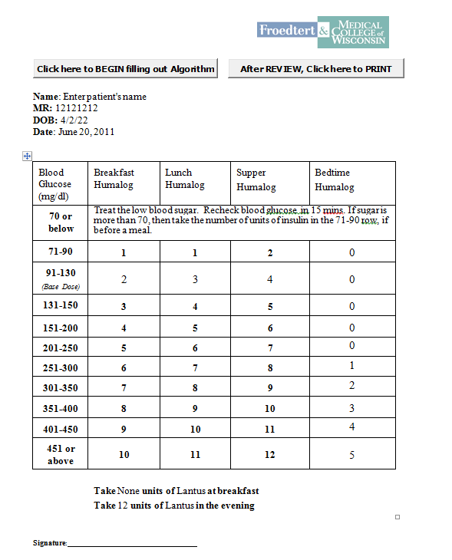
Education Tools
Cornerstones for Care
Novo Nordisk
Mayo Clinic
Individual calorie plans
Carb counting books
Insulin dosing tables
Sliding scale
Starting dose
Dose conversion
Carb counting
Notes:
Mayo & Novo resources – good for diabetes progression
Depression and Diabetes handout. Very common for patients who have diabetes to also have depression
Up to Date for best practice referances,

Slide 14
Education Tools
Up to Date- Best Practice Guidelines, medication reference, some higher level patient education material
Depression and Stress Handout/ GLP-1
Insulin practice pens and injection models
Motivational Interviewing videos, free seminars offered, books.

Slide 15
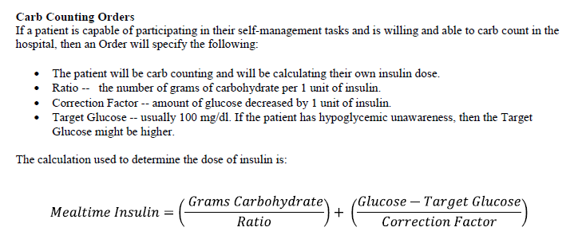
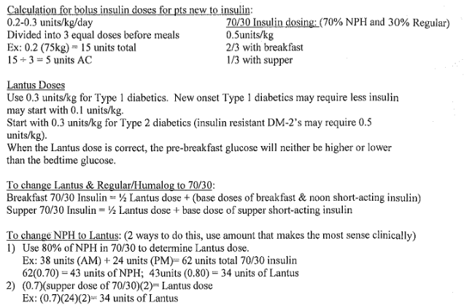

Slide 16
Clinical Pharmacist Role
Drug information resource
Answer medication-related questions from patients and providers
Review current guidelines, literature, and online databases
Provide recommendations for therapy selection

Slide 17
Clinical Pharmacist Role
Medication management
Perform profile reviews to ensure safety and efficacy of drug therapy
Review current medications, labs, vitals
Discuss recommendations with clinic team
Simplify or manage complex regimens
Adherence assessments
Help optimize diabetes therapies and manage diabetes-related disease states (e.g., hypertension, dyslipidemia/ASCVD risk)
Review for drug interactions or contraindications to therapy
Notes:
Recommend adjustments for patients not meeting their goal
Image: https://www.bing.com/images/search?view=detailV2&ccid=LLmhYqzU&id=97B422A6F7FBF3ED72C68804ADB6E68F8A3751A9&thid=OIP.LLmhYqzUwkruF7SImopD7QHaFC&mediaurl=https%3a%2f%2fwww.psychiatry-cloud.com%2fwp-content%2fuploads%2f2015%2f04%2fmedication_management.jpg&exph=244&expw=359&q=medication+management&simid=608034846276390419&selectedIndex=3&ajaxhist=0

Slide 18
Clinical Pharmacist Role
Patient education
Disease state education
Discussion of rationale behind drug therapy choices
Counsel on new and refill medications
Device teaching (e.g., inhalers, injectables, glucometer)
Administration and storage
Adverse reactions and how to manage
Reinforce healthy lifestyle changes
Nutrition
Physical activity
Weight loss
Tobacco cessation
Notes:
Image 1: https://www.bing.com/images/search?view=detailV2&ccid=pDftlcJh&id=24C21C93AE3C5190A7337AABFF4570D7656F3BD3&thid=OIP.pDftlcJhE8Ts2dqC-pujlwHaE8&mediaurl=https%3a%2f%2fdrugpackage.com%2fwp-content%2fuploads%2fBenefitsOfPharmacist.png&exph=800&expw=1200&q=pharmacist+patient+education&simid=608023924178946087&selectedIndex=12&ajaxhist=0
Image 2: https://www.bing.com/images/search?view=detailV2&ccid=Z9gQhkOx&id=C0E78B17DE4905539EE3E88C7C01FF9C3D4AA4B1&thid=OIP.Z9gQhkOxBaWg8WnC-9iMWgHaF0&mediaurl=http%3a%2f%2f3.bp.blogspot.com%2f-sBMHbVuOPwo%2fUbBwmy3BRbI%2fAAAAAAAABWM%2f4v4BW9tOddc%2fs1600%2fhealthy-lifestyle-changes-for-good-health.png&exph=373&expw=475&q=healthy+lifestyle+changes&simid=608031337287779186&selectedIndex=0&ajaxhist=0

Slide 19
Motivational Interviewing
“A collaborative, person-centered form of guiding to elicit and strengthen motivation for change”
Collaboration
Evocation
Autonomy
Miller WR, Rollnick S. Motivational Interviewing, 2nd ed. New York. Guilford Press, 2001
Notes:
Collaboration between patient and provider; evoke useful responses and desire to make changes; autonomy to make decisions,
Patients are most likely to make and sustain health behavior changes with this technique versus having a health professional dictate the best course of action to them.

Slide 20
Motivational Interviewing Principles
Express empathy | Helps the patient feel understood and respected | “You seem…” “It sounds like…”
Support self-efficacy | Confidence in ability to change Significant predictor of engagement in health behavior change | “Taking your medications regularly as you have been will really help continue to bring your blood sugar down.”
Avoid argumentation | Ignore antagonistic statements and personal attacks | Avoid “yes, but…” statements
Rolling with resistance | Explore resistance with open-ended questions | “May I tell you what concerns me?” “I hope you see me as a resource for information when you’re ready.”
Developing Discrepancy | Creating a motivating dissonance Meant to be thought-provoking to get the patient to think about change | “So, on one hand you want to check your blood sugar to improve your diabetes control, but on the other hand, you don’t want to because you don’t like sticking yourself?”
Kavookjian J. Motivational Interviewing. PSAP-VIII. Science and Practice of Pharmacotherapy. https://www.accp.com/docs/bookstore/psap/p7b08.sample01.pdf
Notes:
5 main communication principles in motivational interviewing

Slide 21
Closed-ended questions | Open-ended questions
Can you tell me what your doctor told you about having diabetes? | Tell me what you know about diabetes and how high blood sugar readings put your health at risk.
Have you been limiting your salt intake to help with your high blood pressure? | What is your understanding about the impact of salt in the foods you eat on your blood pressure?
Have you tried walking to increase your physical activity? | What are some things you can think of to incorporate more activity into your routine?
Did you every miss any of your medications? | About how many pills did you miss in the past week?
Kavookjian J. Motivational Interviewing. PSAP-VIII. Science and Practice of Pharmacotherapy. https://www.accp.com/docs/bookstore/psap/p7b08.sample01.pdf
Notes:
Importance of answering open-ended questions.

Slide 22
How do you utilize team-based care in your clinics? How do you encourage collaboration among health care professionals?

Slide 23
Case Example
31 Year old Female presented in May 2018
-Hx of Type 2 DM, obesity, depression, anxiety, asthma.
-Sx: Blurred vision, increased thirst, nausea, fatigue, confusion, increased urination.
-Initially presented with sinusitis, elevated blood glucose levels (195-406), and severe depression.
-Treated with Metformin 1000 mg BID for several years. Started glipizide 5 mg BID a month prior.
-Patient’s diet was carb-based. Rarely ate breakfast.
-Poor sleeping habits.
Notes:
Amber

Slide 24
Progression of Interventions
-Labs were ordered at initial appointment. A1C 10.3%. Urine + for >1000 mg/dL glucose and ketones.
-Started CDE visits weekly or biweekly
-Started counseling sessions with clinic counselor
-Scheduled with dietitian monthly (patient needed 2 visits)
-Started Long-acting insulin and GLP-1 on 5/31/18
-Providers started adjusting depression and anxiety meds.
-Short-acting insulin added on 6/21/18 and patient saw dietitian.
-Custom SSI started on 6/30 for different meals .
-Patient saw Psychiatrist on 8/21/18. Meds adjusted again.
-Blood glucose in tight control on 7/10/18

Slide 25
Results
Patient states that she feels great (Mood is stabilized)
Blood glucose log is very consistent
Patient is more active
Diet is more consistent and well balanced
Patient is in control of her health outcomes and feels empowered
A1C is now 7.9%

Slide 26
Thank You!
Contact:
Stacy.wolf@froedtert.com
Direct Office Line
262-257-2394

