Slide 1
AHA tools for quality chronic disease management
Safety Net Summit: Clinical Track
Tim Nikolai,
Sr. Community Impact Director
Oby Nwabuzor,
Community Impact Director

Slide 2
Disclosures
We have no actual or potential conflict of interests involving the materials in this presentation.
We are not clinicians or trained medical professionals.

Slide 3



Our (New) MISSION STATEMENT
“To be a relentless force for a world of longer, healthier lives.”
Notes:
Oby

Slide 4
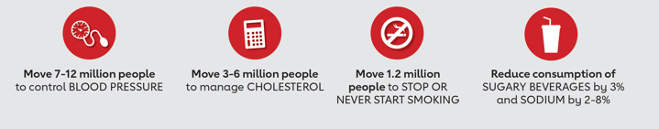
OUR 2020 Impact Goal
The Goal: To improve the health of all Americans by 20% by the year 2020 while further reducing death from cardiovascular diseases and stroke by 20%.
Status: On track for reduction of death; not on track for health improvement
Focus areas until 2020 (and beyond):
Notes:
Oby

Slide 5
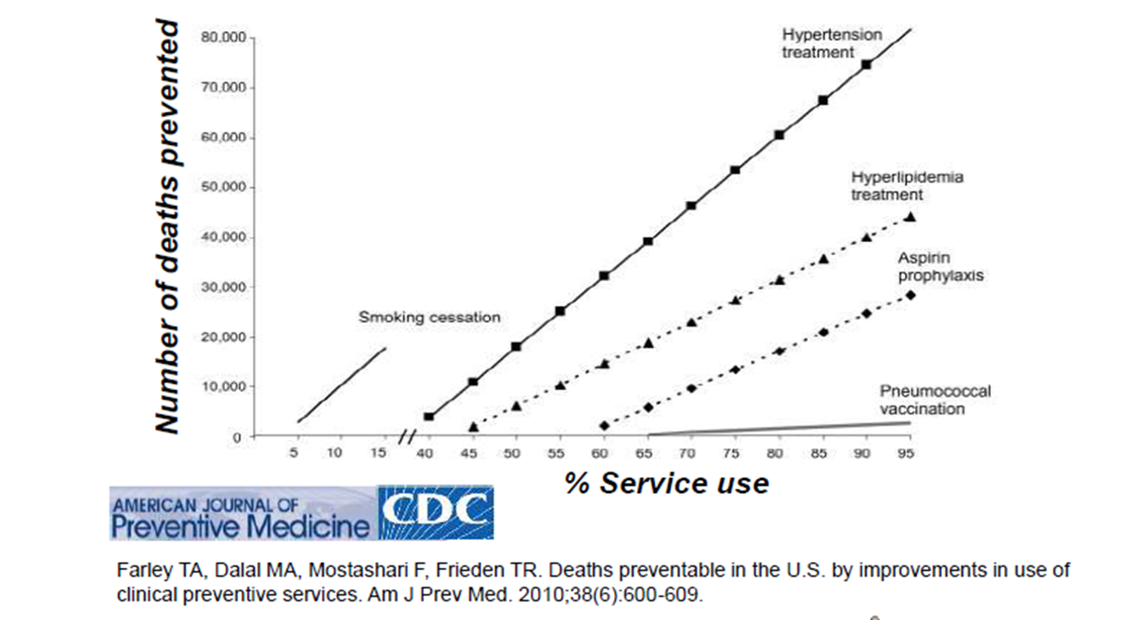
The Opportunity Before us
Notes:
Tim

Slide 6
Synergy of Focus
WAFCC Vision: A culturally appropriate health care community that provides free or affordable health services that promotes the elimination of health disparities among the uninsured, underserved, economically and socially disadvantaged, and vulnerable populations of Wisconsin.
WAFCC Standards Overview: Standards are the distilled wisdom of people with expertise in their subject matter and who know the needs of the organizations they represent... Standards are knowledge.
American Heart Association: Using our trusted platform to pursue health equity for all.
Eduardo Sanchez, CMO, American Heart Association: Engaged care teams achieving better outcomes will mean more patients will avoid life-altering events, contributing to a healthier America.
Notes:
Tim

Slide 7

Connection to WAFCC Standards
OPC2b.1 Clinic uses materials for self-management and shared decisions
GAM3a.5 Document of education methods to help patient understanding
GAM4a.1 Clinic implements quality improvement practices
GAM4b.1 Clinic collects record data for demographics & clinic performance
CR1.2 Clinic seeks out partnerships to ensure access to essential resources
Notes:
Tim

Slide 8

The Resulting Efforts
Both programs:
Provide clinical guidelines and protocols
Offer free resources for both providers and patients
Connect clinical partners to others around the country engaged in the same work
Offer recognition opportunities for any health care provider that demonstrates a commitment to, and/or achieve, clinical excellence.
Notes:
Oby

Slide 9
Addressing Hypertension
Notes:
Oby

Slide 10
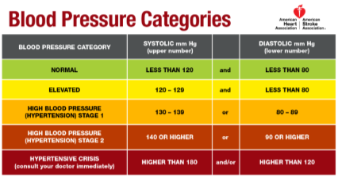
New Clinical Guidelines
The American Heart Association & American College of Cardiology
have updated the guidelines for hypertension control.
Notably, the guidelines eliminate the diagnosis of
pre-hypertension and identifies anything greater than 130 or 80 as Stage 1 hypertension.
Heart disease and stroke risk is doubled at 130/80 compared to blood pressure below 120/80.
100+ million American adults have hypertension and approximately 46% are uncontrolled.
Notes:
Oby
ABC News called November’s launch of new blood pressure guidelines one of the top health stories of the year.
Change/adaptation can take a while but we’re hopeful that doing things like eliminating prehypertension as a diagnosis and underscoring how even levels moderately above 120/80 will be a call to action for both patients and providers.

Slide 11
Top 5 Takeaways from new HTN Guidelines
Classification of Blood Pressure: Four new BP categories based on the average of two or more in-office blood pressure readings.
Prevalence of High Blood Pressure: Substantially higher prevalence of HTN under the new guideline, 46% of U.S. adults vs 32%, based on JNC 7.
Treatment of High Blood Pressure: All patients with blood pressures > normal should utilize nonpharmacological interventions. Use of BP-lowering medications is recommended based on stage of HTN, individual medical history or est. CVD risk ≥ 10% using the ACC/AHA Risk Estimator.
Blood Pressure Goal for people with High Blood Pressure: For adults with confirmed hypertension and known CVD, or 10-year ASCVD event risk of 10% or higher, a BP goal of less than 130/80 mm Hg is recommended.
5. Use Self-measured Blood Pressure Monitoring (SMBP) to Diagnose, Reassess, and Activate Patients with High Blood Pressure.
Notes:
Oby
Here are the Top 5 takeaways from the new guidelines.
As I shared we eliminated prehypertension a diagnosis and altered the rest of the chart according to science.
Prevalence rates went up as you would expect. Point 3 is important because these guidelines, if proper preventative action is taken, should lead to only a very small increase in pharmacological treatment while emphasizing lifestyle modification to get to no. 4.
Finally, as I’ll share briefly, there is a greater emphasis on Self-Measurement of BP.

Slide 12
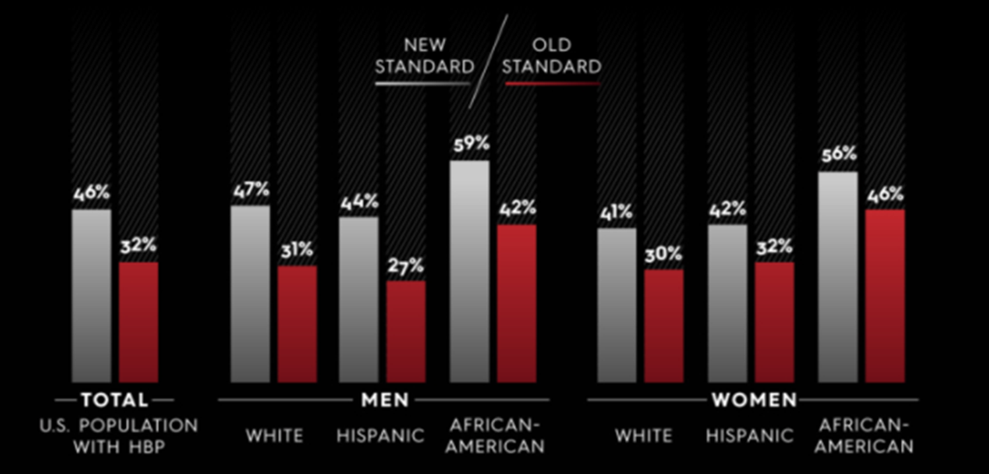
Health Inequity: Hypertension rates by gender and ethnicity.
Notes:
Oby

Slide 13
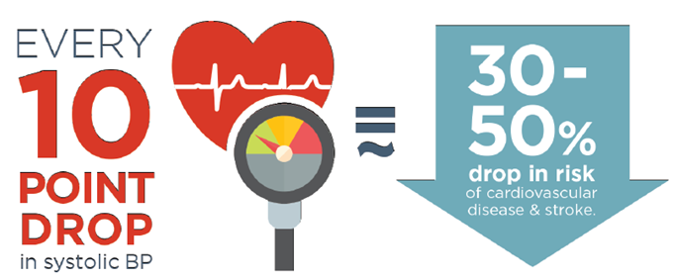
The Potential for iMpact
Notes:
Tim

Slide 14

Barriers to success
System factors
  Quality reporting
  Work flow
  Leadership buy-in
Provider factors
  Time
  Financial
  Knowledge of evidence
Patient factors
  Non-adherence
  Financial
  Literacy
Notes:
Tim

Slide 15
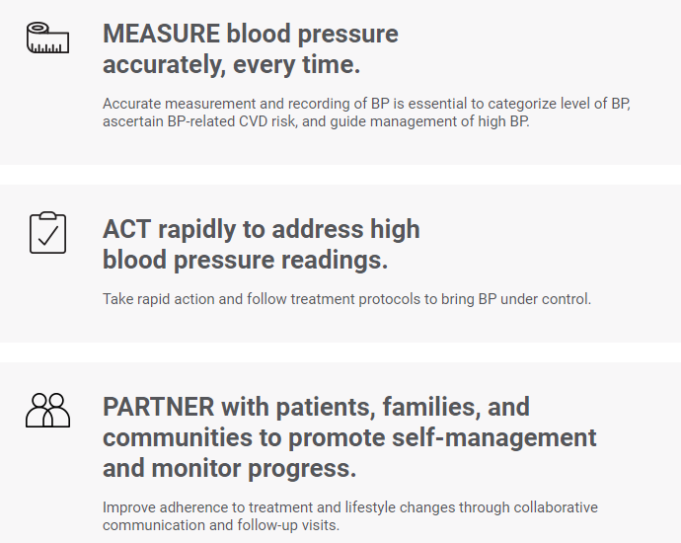
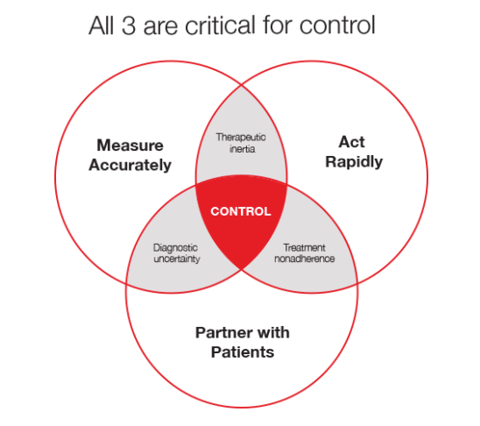
The M.A.P. Framework
Notes:
Firstly, just as in the case of a STEMI or other cardiac emergency, Target: BP encourages systems to adopt a protocol for HTN, specifically the MAP Treatment algorithm. Our platform then builds out resources around each of those steps in the treatment mapping.

Slide 16
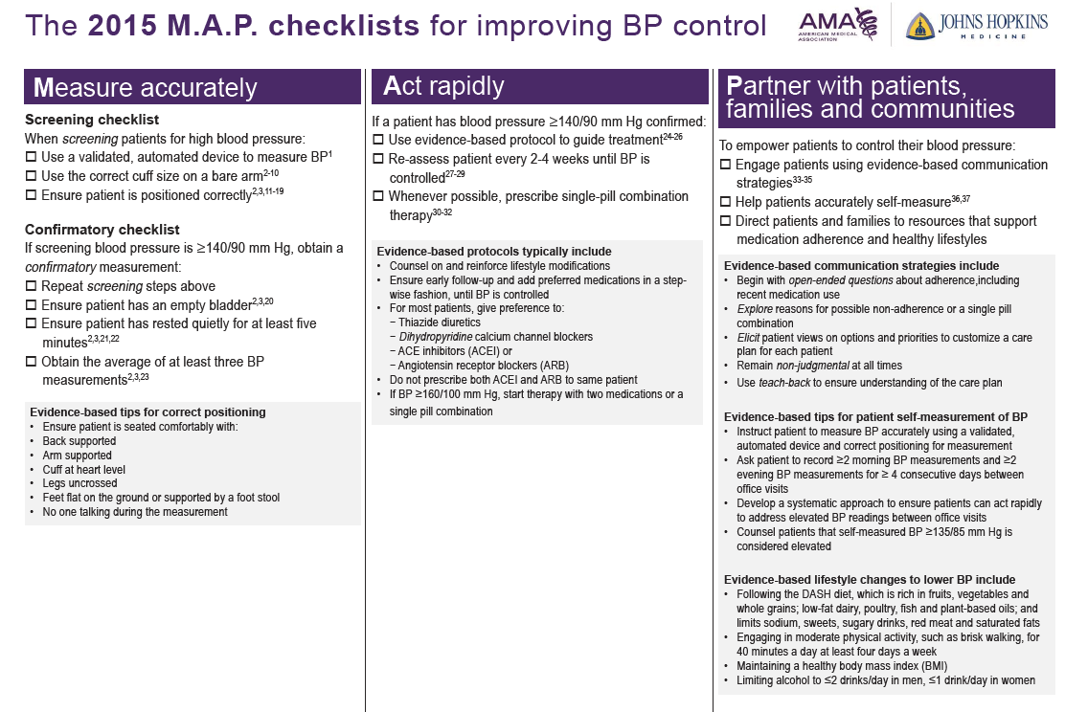
Notes:
Tim

Slide 17
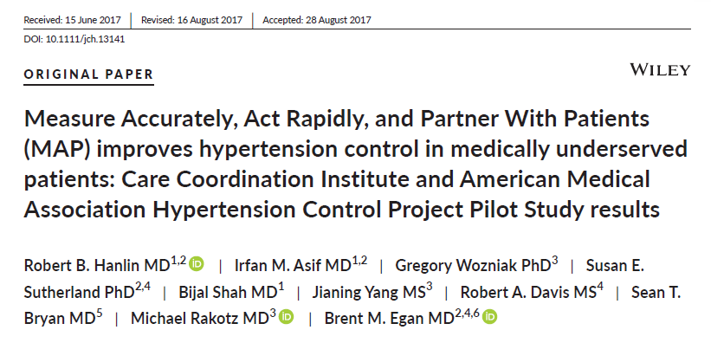
The Impact of M.A.P. in Greenville S.C.
Resource limited clinic
50% African American and 50% Medicare population
6 month study of about 714 hypertensive patients with at least one visit (70+ % had 2 visits and 49% had three visits
Control rate for those who visited at least once during the study increased by 28 pts from 61 to 89 pts
Notes:
Tim

Slide 18
WHY is Measuring Accurately so important
BP variability exists in everyone and contributes to uncertainty about whether any single BP is representative of a patients true BP
Uncertainty about BP is the leading reason clinicians fail to initiate and escalate therapy to patients with uncontrolled high BP
Conventional or routine office BP measurement correlate poorly with a patient’s true BP and future cardiovascular events
Poorly performed BP measurements (which are very common) result in inaccurate BP readings, contributing to uncertainty and potential harm to patients over time
How does this affect clinicians in practice?
Kerr E et al. The Role of Clinical Uncertainty in the Treatment Decisions for Diabetic Patients with Uncontrolled Blood Pressure. Annals of Internal Medicine (148) Number 10 717-727
Notes:
Oby

Slide 19
Impact of the clinical setting on bp
Almost all patients will experience some degree of the alerting response in a clinical setting:
  White coat hypertension: Office BP ≥ 130/80 mm Hg in a patient whose out of office BP is not elevated
Some will experience none at all, or the opposite:
  Masked hypertension: Office BP 120-129/< 80 mm Hg in a patient whose out of office BP is in the hypertensive range ≥ 130/80 mm Hg
Notes:
Oby
Firstly, just as in the case of a STEMI or other cardiac emergency, Target: BP encourages systems to adopt a protocol for HTN, specifically the MAP Treatment algorithm. Our platform then builds out resources around each of those steps in the treatment mapping.

Slide 20
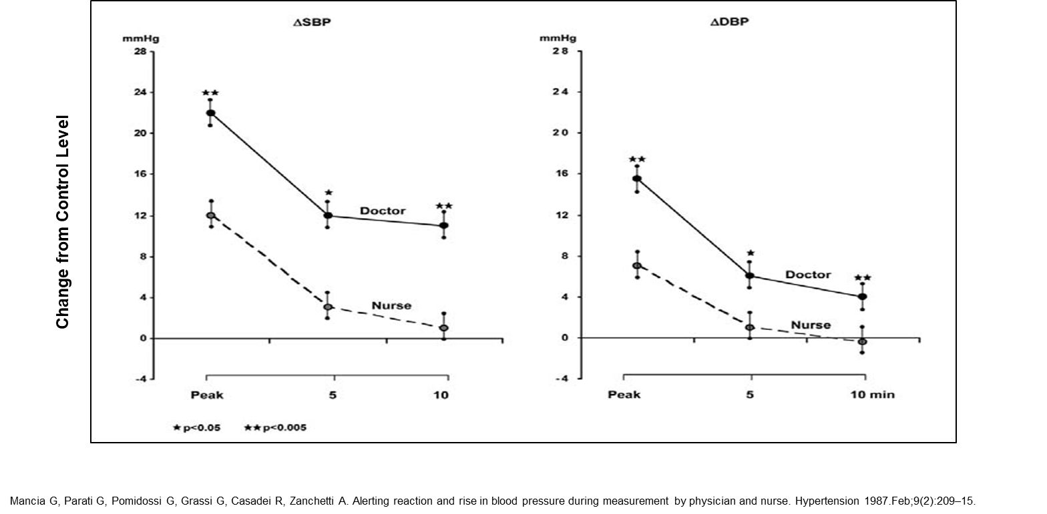
Alerting Response
Notes:
Tim

Slide 21
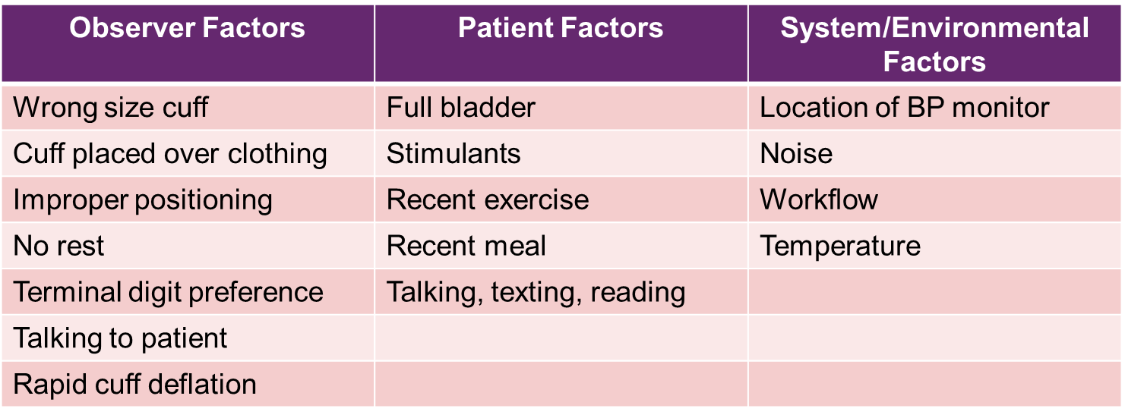
Common Measurement Errors
Notes:
Tim

Slide 22
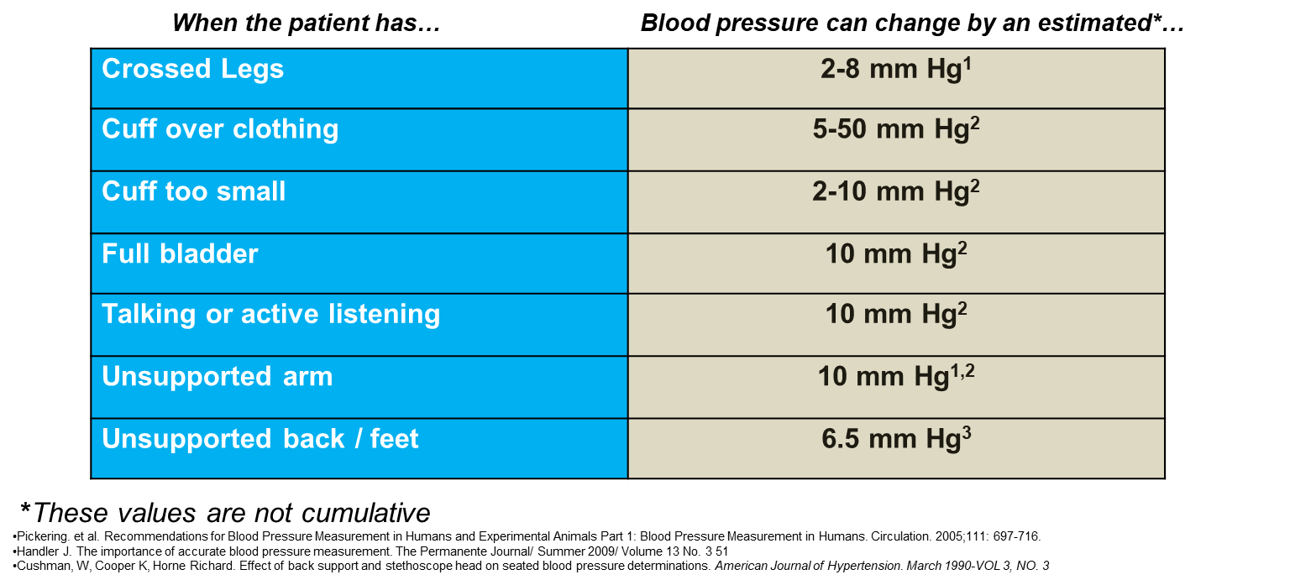
Impact of Errors
Notes:
Tim

Slide 23
Terminal Digit Preference in Manual BP
Rounding to 0, 5, and 9 is extremely common (80-85% in some studies)
More recently trends are towards BPs ending in 8 or 9, likely related to meeting quality measure targets.
Eliminated with automated devices if displayed BP is documented
Notes:
Tim

Slide 24
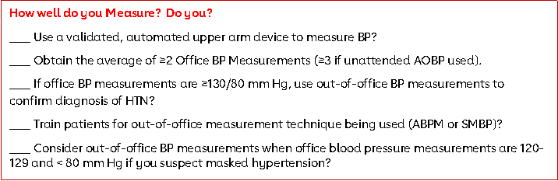
Practice Assessment Tool – Measure Accurately
Notes:
Oby

Slide 25
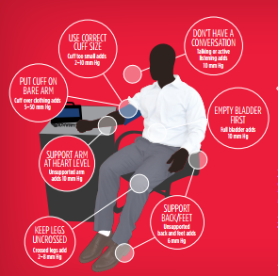
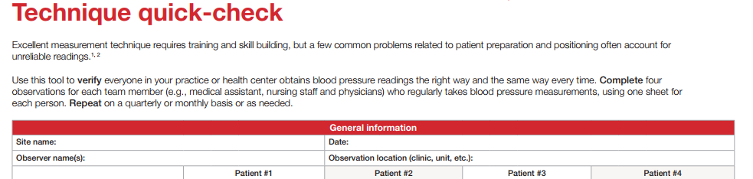
Target: BP Resources on Measuring Accurately
Technique quick check
Positioning materials and quiz
Webinars and case studies
Resources to support home-monitoring
Notes:
Oby

Slide 26
Most common factors relating to uncontrolled HTN
Clinicians miss opportunities to treat a patient with a high BP
  Fail to initiate or escalate therapy during an office visit
  Fail to stress frequent follow up until BP is controlled
THERAPUTIC INERTIA
Patients don’t follow their treatment plan
  Usually due to not taking medications as instructed
TREATMENT NON-ADHERENCE
Notes:
Tim

Slide 27
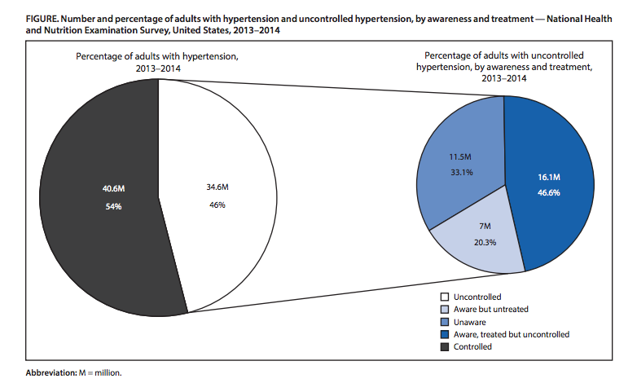
Why Treatment protocols are important
Merai R, Siegel C, Rakotz M, et al. CDC Grand Rounds: A Public Health Approach to Detect and Control Hypertension. MMWR Morb Mortal Wkly Rep 2016;65:1261–1264.
Notes:
Tim
I wanted to share this image which I think speaks to why acting rapidly is important.
In the circle on the left you see individuals with hypertension broken down into controlled and uncontrolled. So you see 54% of individuals with hypertension in the United States were controlled and 46% were uncontrolled.
The circle on the right looks deeper into the uncontrolled population and breaks it down into individuals that are aware of their hypertension but untreated, individuals that are unaware of their hypertension and individuals that are aware of their hypertension and are being treated but still uncontrolled. Just imagine the improvements in health outcomes we could make if we could move the needle with these individuals and help them control their hypertension.

Slide 28
Therapeutic inertia: Contributing factors
CLINICIAN FACTORS
Uncertainty about accuracy of office BP measurements¹
Failure to diagnose High BP
Failure to recommend frequent follow-up
Failure to titrate Tx to goal
Competing priorities
Not addressing patient needs
PATIENT FACTORS
Absence of symptoms
Failure to take meds
Medication side effects
Cost of medications
Denial of disease
Mistrust of clinician
Low health literacy
HEALTH SYSTEM FACTORS
Lack of treatment protocol
Poor communication between staff
No hypertension registry
No performance dashboards/reports
Notes:
Tim
Clinician Factors:
1.Boonyasai RT, Rakotz MK, Lubomski LH, et al. Measure accurately, act rapidly, and partner with patients: an intuitive and practical three- part framework to guide efforts to improve hypertension control. J Clin Hypertens (Greenwich). 2017;19:684-694.
2.Robina Josiah Willock, Joseph B. Miller, Michelle Mohyi et al. Therapeutic Inertia and Treatment Intensification. Current Hypertension Reports (2018) 20: 4 https://doi.org/10.1007/s11906-018-0802-1
3.Lebeau JP, Cadwallader JS, Aubin-Auger I, Mercier A, Pasquet T, Rusch E, et al. The concept and definition of therapeutic inertia in hypertension in primary care: a qualitative systematic review. BMCFam Pract. 2014;15(1):130. https://doi.org/10.1186/1471-2296-15-130.
\. 2006;47:345‐351.
5. Holland N, Segraves D, Nnadi VO, Belletti DA, Wogen J, Arcona S. Identifying barriers to hypertension care: implications for quality improvement initiatives. Dis Manag. 2008;11(2):71–7. https://doi.org/10.1089/dis.2008.1120007.
7. Kerr EA, Zikmund-Fisher BJ, Klamerus ML, Subramanian U, Hogan MM, Hofer TP. The role of clinical uncertainty in treatment decisions for diabetic patients with uncontrolled blood pressure. Ann Intern Med. 2008;148:717‐727.

Slide 29
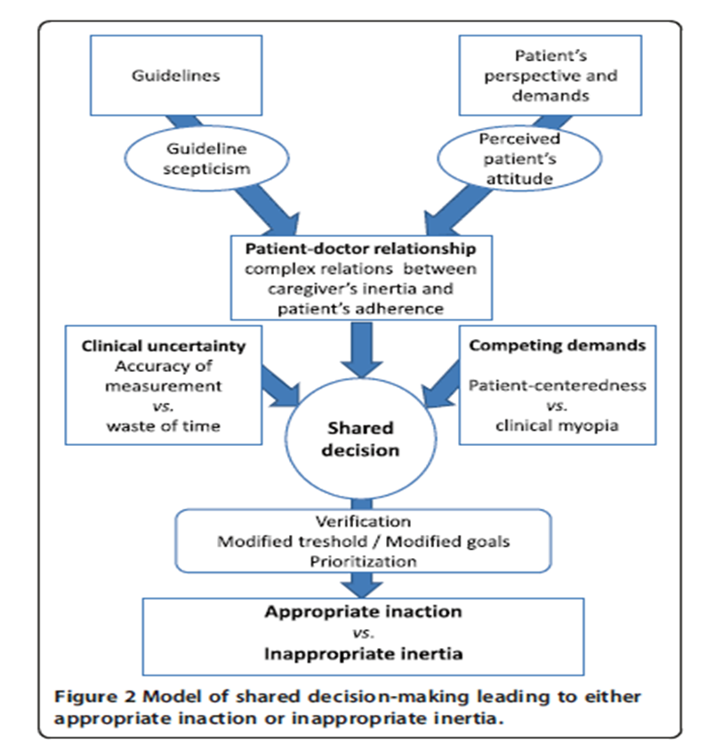
Implementing Treatment protocols
Using treatment protocols can improve BP control
Having a “playbook” can help the entire care team
Everyone can better understand:
1) Who needs treatment
2) What treatment should be used
3) When follow up should occur
Xu et al. BMJ 2015;350:h158 doi: 10.1136/bmj.h158
Notes:
Tim
Most national experts in hypertension recommend using treatment protocols.
Treatment algorithms are like having a playbook for hypertension.
It helps to make it very clear to everyone on the team
When patients need treatment
What the treatment should be
And how soon follow up should occur

Slide 30
Protocol Considerations and Reminders
Treatment protocols should not replace sound medical judgement
Pick a protocol that works best for your practice and your population, or create your own
Consider and account for your population (different races and comorbidities may need certain medications)
Protocols available online:
  AHA/ACC/CDC High Blood Pressure Algorithm
  Million Hearts® Protocol for Controlling Hypertension in Adults
  Kaiser Permanente Clinical Practice Guideline for Adult Hypertension
Notes:
Tim
So just a few items to consider when your practice is determining how to best use an algorithm in your environment.
Algorithms are meant to serve as guidance and can help get everyone on the same page-but in no way are they meant to replace sound medical judgement. There will be times when what is in the algorithm may not be best for the patient and in those situations treatment should be customized to the patient’s individual needs
There are many algorithms available so pick one that works best for your practice and your population or create your own. The million hearts link on the slide has many examples of algorithms including the VAs, Kaiser which as you may know is a leader in hypertension control-they found a lot of success in using single-pill combination therapy and in fact were able to increase their control rate to 90%. The million hearts website also has a template which you can use to build your own algorithm.
The other link is one of our fast fact sheets which is a quick one pager which talks about the importance of using an evidence-based treatment algorithm

Slide 31
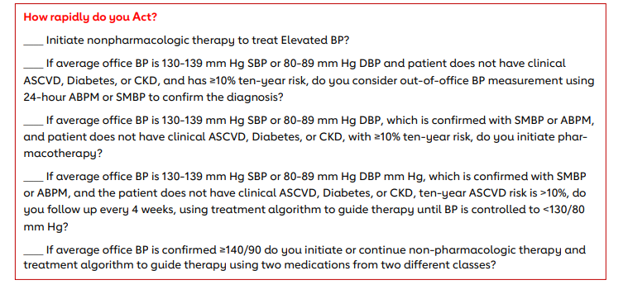
Practice Assessment Tool – Act Rapidly
Notes:
Oby

Slide 32
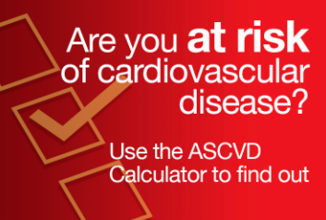
Target: BP Resources on Acting Rapidly
Case studies for team-based care/practice coordination
ASCVD Risk Calculator – available as an app or on the web
Positioning materials and quiz
Notes:
Oby

Slide 33
Evidenced Based Communication Strategies
Strategy | Example
Begin with open-ended questions about adherence, including recent medication use | AVOID: “Are you taking your medicines?” TRY: “How are your medications working for you?”
Address “red flags” e.g., missed appointments, prescription refills, requested labs, and lack of therapeutic response to medication change | AVOID: “Why did you miss your appointment?” TRY: “I noticed you missed your clinic visit two months ago. Is there something we can do to help you get your follow-up care?”
Explore reasons for possible non-adherence | AVOID: “Let me prescribe a different pill that might work better.” TRY: “What do you think would make it easier?”
Elicit patient views on options and priorities to customize a care plan for each patient | AVOID: “Have you considered using a pillbox?” TRY: “What do you think would work for you?” or “What have worked for you in the past?”
Remain non-judgmental at all times | AVOID educational statements: “It’s really important to take your pill if you want to control your blood pressure.” TRY supportive statements: “Let’s think about this problem together, maybe we can come up with something that will work for you.”
Use teach-back to ensure understanding of the care plan | AVOID close-ending question: “Does this make sense to you?” TRY: “What is your understanding of what we’ve discussed today?”
Notes:
Oby

Slide 34
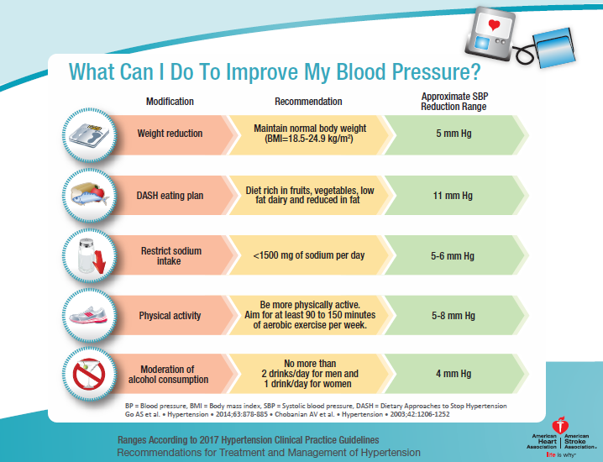
Non-Pharmacological Lifestyle modifications
Notes:
Oby

Slide 35
Strategies to improve medication adherence
Educate patients on use, importance and effectiveness of medication
Prescribe once daily medications when able
Prescribe generic medications whenever possible
Use single-pill combination therapy if possible
Provide 90-day prescriptions when applicable
Recommend that the patient work with their pharmacy to coordinate pill refills for the same date
Identify and address financial barriers patients may be experiencing
Address issues of medication complexity, side, effects and denial of disease process
Work with the pharmacy to determine if blister packs are appropriate for the patient
Notes:
Tim

Slide 36
Why use SMBP?
Can increase precision of diagnosis
Patients with elevated office BPs who are suspected of having HTN (to make a diagnosis) (2015 USPSTF and 2017 ACC/AHA Guideline recommendation)
Differentiates between white coat and sustained HTN
    Adults with an untreated systolic blood pressure (SBP) >130 mm Hg but <160 mm Hg or diastolic blood pressure (DBP) > than 80 mm Hg but < 100 mm Hg
  Helps to identify patients with masked HTN
    Adults with untreated office BPs that are consistently between 120 mm Hg and 129 mm Hg for SBP or between 75 mm Hg and 79 mm Hg for DBP
Notes:
Tim

Slide 37
Why use SMBP?
SMBP can improve the maintenance of blood pressure
  Provides a reliable estimate of effectiveness of antihypertensive treatment
  Assesses control at different times across a 24 hour period
  Allows for better treatment decisions to be made in a timely fashion
  SMBP can improve adherence to therapy
  Empowers patient to be more involved to self-manage
  May improve medication adherence with clinical support
Notes:
Tim

Slide 38
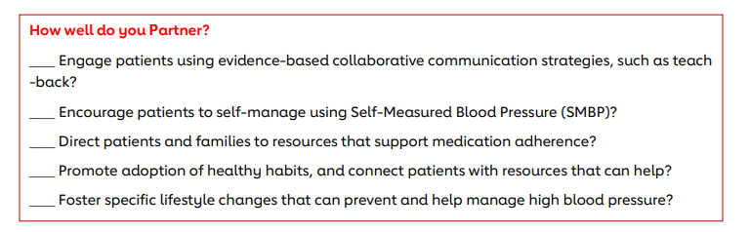
Practice Assessment Tool – Partner with Patients
Notes:
Oby

Slide 39
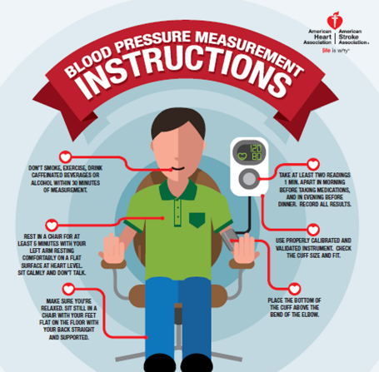
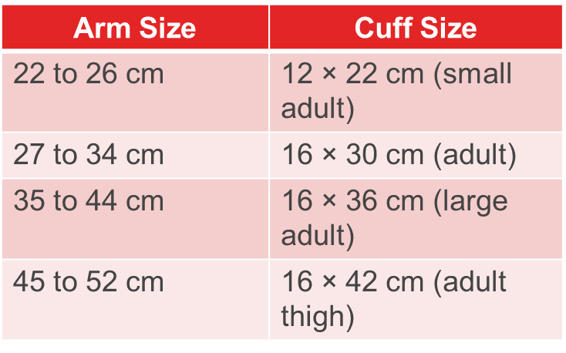
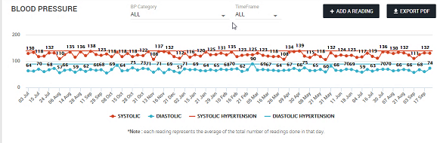
Target: BP Resources on Partnering with Patients
Questions to ask your doctor
Medication Adherence
Self-Monitored Blood Pressure
  Device validation tests/lists
  Information on a loaner program
  Cuff size information
  Check, Change, Control® Tracker
  Lifestyle modification information
    Also available for hosting as an employer, church, or other organization
Notes:
Oby

Slide 40
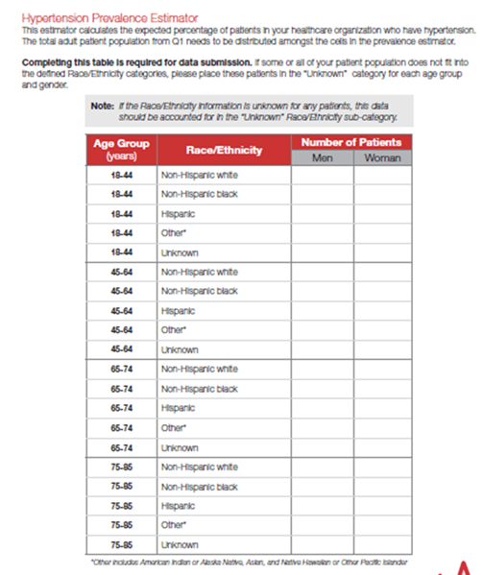
Target: BP and Your Clinic/Practice
Register to participate at www.TargetBP.org.
  Additional staff can register for the newsletter only
Work through the Clinical MAP Assessment
  Engage with resources and AHA staff on identified priorities and action steps
Be prepared to submit blood pressure control data starting in February 2019.
  Data submission is based on NQF 0018 and the Million Hearts Prevalence Estimator
Notes:
Oby

Slide 41
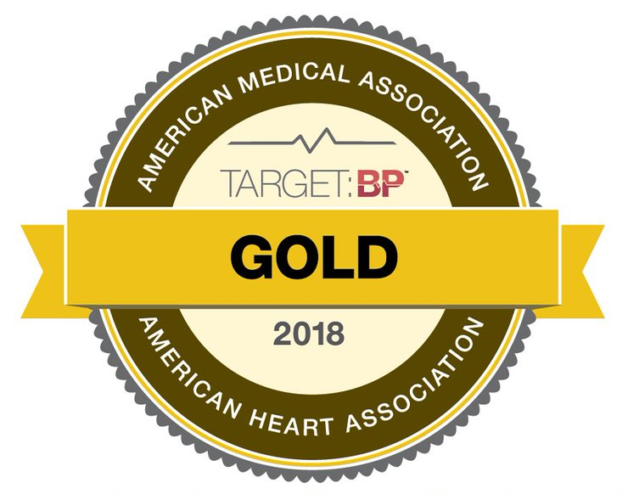
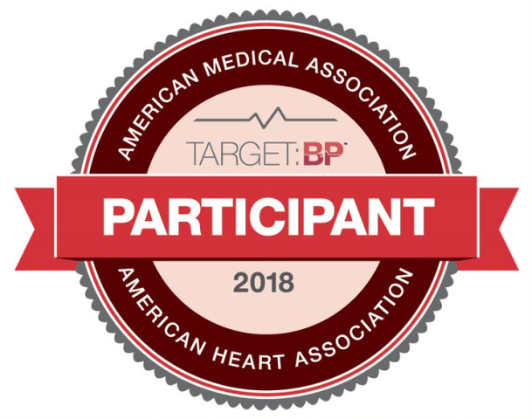
Target: BP – 2018 Wisconsin Awardees
Bellin Health
Divine Savior Healthcare
Gundersen Health System
Muslim Community and Health Center
Northern Health Centers, Inc
ThedaCare
Milwaukee Health Services, Inc.
St. Ann Center for Intergenerational Care
Notes:
Oby

Slide 42




Target: BP – WAFCC Awardees
Muslim Community and Health Center
St. Ann Center for Intergenerational Care
Notes:
Oby

Slide 43

Addressing Cholesterol
Notes:
Tim

Slide 44
Check. Change. Control. Cholesterol (CCCC)- Overview
Check. Change. Control. Cholesterol™ is a national initiative sponsored by Sanofi and Regeneron to bring Cholesterol management to the attention of patients and providers.
High Cholesterol is a major risk factor for cardiovascular disease and stroke, the No. 1 and No. 5 killers in the U.S.
Notes:
Tim

Slide 45
Existing Cholesterol Guidelines
The 2013 ACC/AHA Prevention Guideline shifted from treatment to a target LDL cholesterol goal to treatment based on 10-year risk of having an atherosclerotic cardiovascular disease (ASCVD) or stroke event:
  2013 ACC/AHA Guideline on the Assessment of Cardiovascular Risk. Goff, Circulation (2013)
  2013 ACC/AHA Guideline on the Treatment of Blood Cholesterol to Reduce Atherosclerotic Cardiovascular Risk in Adults. Stone, Circulation (2013)
Notes:
Tim

Slide 46
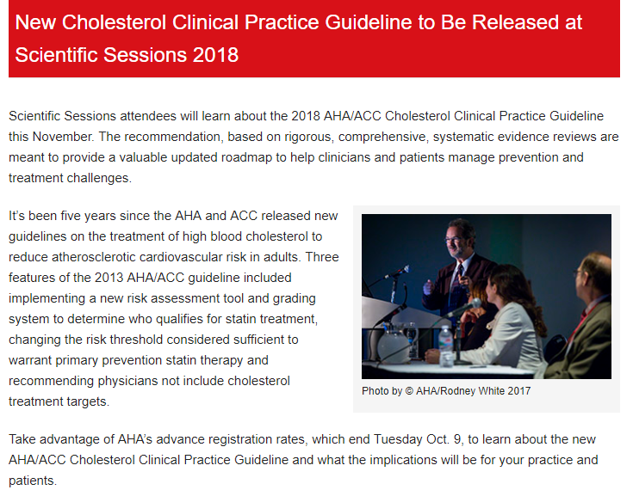
New Cholesterol Guidelines
Notes:
Tim

Slide 47
ASCVD Risk Calculator
The ASCVD risk calculator is an evidence-based tool that was developed in conjunction with the 2013 Cholesterol Guidelines.
The risk calculator assesses risk for having a first time cardiovascular or stroke event in the next 10 years
A risk of 7.5% or greater should prompt providers and patients to discuss lifestyle changes and further treatment options (e.g., statin prescription)
  Currently less than half of stroke patients receive the suggested statin prescription
Online tools are available for providers and patients to estimate 10-year risk:
          ASCVD Risk Estimator (provider tool)
          Check. Change. Control. Calculator (patient tool).
          Many EMRs are integrating the tool.
Notes:
Tim

Slide 48
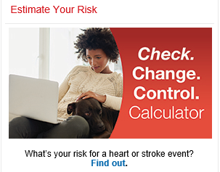
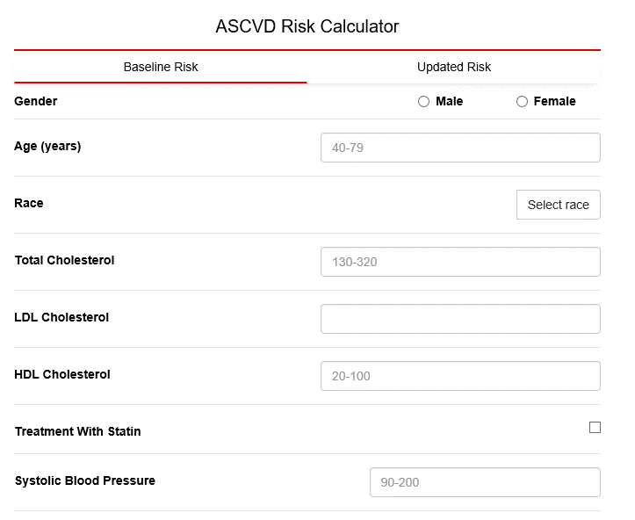
ASCVD Risk Calculator (Cont.)
Patient Calculator
Provider Calculator
www.heart.org/ccccalculator
www.professional.heart.org/ascvd
Notes:
Tim

Slide 49
Why use the ASCVD Risk Calculator?
  The ASCVD Risk calculator is an evidence-based tool for assessing baseline 10-year risk of having a first ASCVD event.
  The calculator can help inform the patient-provider discussion on lifestyle changes and incorporating medications (e.g., statins) to improve cholesterol control and reduce cardiovascular risk.
  The ASCVD risk calculator was included in the 2017 High Blood Pressure Clinical Practice Guideline as a component in treatment decision-making for patients with Stage 1 Hypertension.
  Additional tools have been developed to estimate the potential impact of Aspirin therapy in appropriate patients, Blood pressure control, Cholesterol management, and Smoking cessation (ABCS).
Notes:
Tim

Slide 50
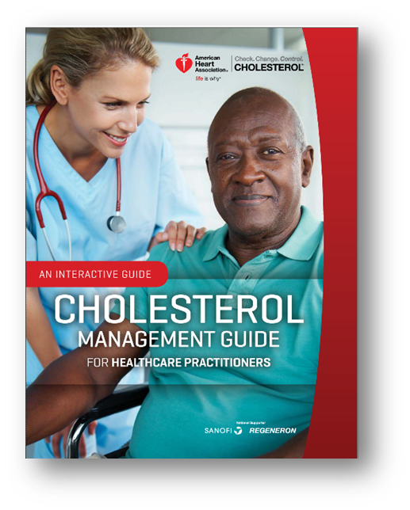
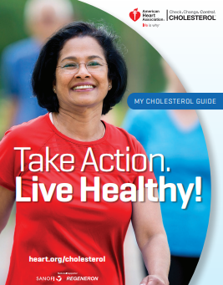
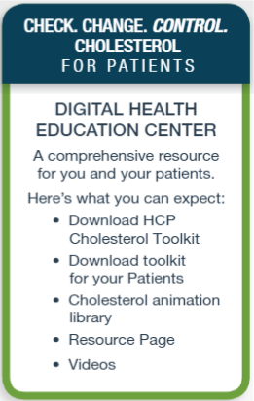
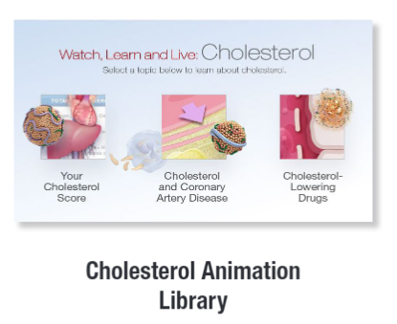
Resources within CCCC
  Tools for patients
  Tools for providers
  Guidance on ASCVD Risk Calculator
  Continuing Education Opportunities
  Newsletters (Coming soon!)
Notes:
Oby

Slide 51
CCCC and Your Clinic/Practice
  Register at www.heart.org/changecholesterol
  Evaluate current use of the ASCVD Risk Calculator
    Explore ways to further integrate into clinical practices and/or EMR
  Prepare to submit data on statin use starting in February 2019
    Data is based on CMS’ MIPS #438
Notes:
Oby

Slide 52
Submission Requirement for MIPS #438
DENOMINATOR (SUBMISSION CRITERIA)
1) Patients aged ≥ 21 years at the beginning of the measurement period with clinical ASCVD diagnosis OR
2) Patients aged ≥ 21 years at the beginning of the measurement period who have ever had a fasting or direct laboratory result of LDL-C ≥ 190 mg/dL or were previously diagnosed with or currently have an active diagnosis of familial or pure hypercholesterolemia OR
3) Patients aged 40 to 75 years at the beginning of the measurement period with Type 1 or Type 2 diabetes and with an LDL-C result of 70–189 mg/dL recorded as the highest fasting or direct laboratory test result in the measurement year or during the two years prior to the beginning of the measurement period
NUMERATOR (SUBMISSION CRITERIA):
1) Patients who are actively using or who receive an order (prescription) for statin therapy at any point during the measurement period
Notes:
Oby

Slide 53
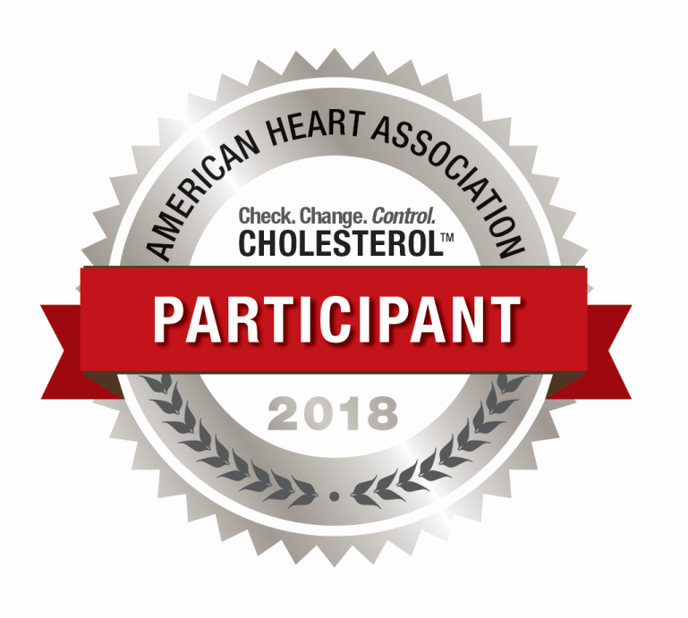
CCCC – 2018 Wisconsin Awardees
Bellin Health
Notes:
Oby

Slide 54
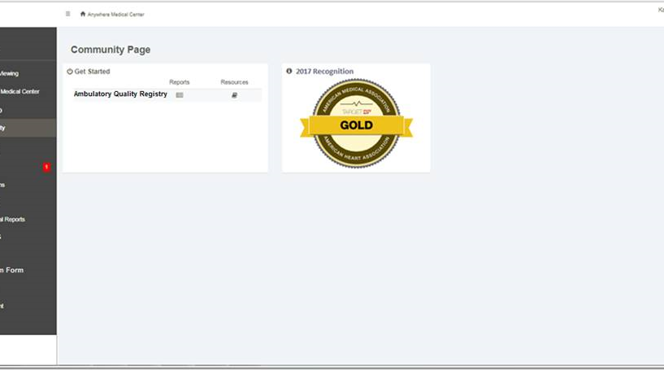
DATA Submission & Recognition for TBP & CCCC
2019 Data submission window will be open from approximately Feb 1 to Jun 1
Data will be based on the respective measures for calendar year 2018
Each program must be registered for separately at their respective home pages
Starting in 2019, data submission for both can be managed in one place, with one Username and Password
Recognition is announced in Fall 2019
Notes:
Oby

Slide 55
SPECIAL Opportunity for WAFCC Members
Every WAFCC Member/Clinic who registers for (each of) Target: BP & Check, Change, Control Cholesterol by Friday, November 16th will:
  Receive a printed education kit with resources from the American Heart Association on the respective chronic condition
  Be entered into a drawing to win a Super Education Kit with additional print resources plus 5 automatic blood pressure monitors for use in support of SMBP.
      Note: Clinics registering for both programs would receive two entries into this opportunity.
Notes:
Oby

Slide 56

Questions?
 | Tim Nikolai Sr. Community Impact Director Tim.Nikolai@heart.org O 414.227.1418 | M 414.502.8780 | Oby Nwabuzor Community Impact Director Oby.Nwabuzor@heart.org O 414.227.1423 | M 262.509.0209

